Slide 1
Appendices of the Code
John Wiersema
21 July 2017

Slide 2
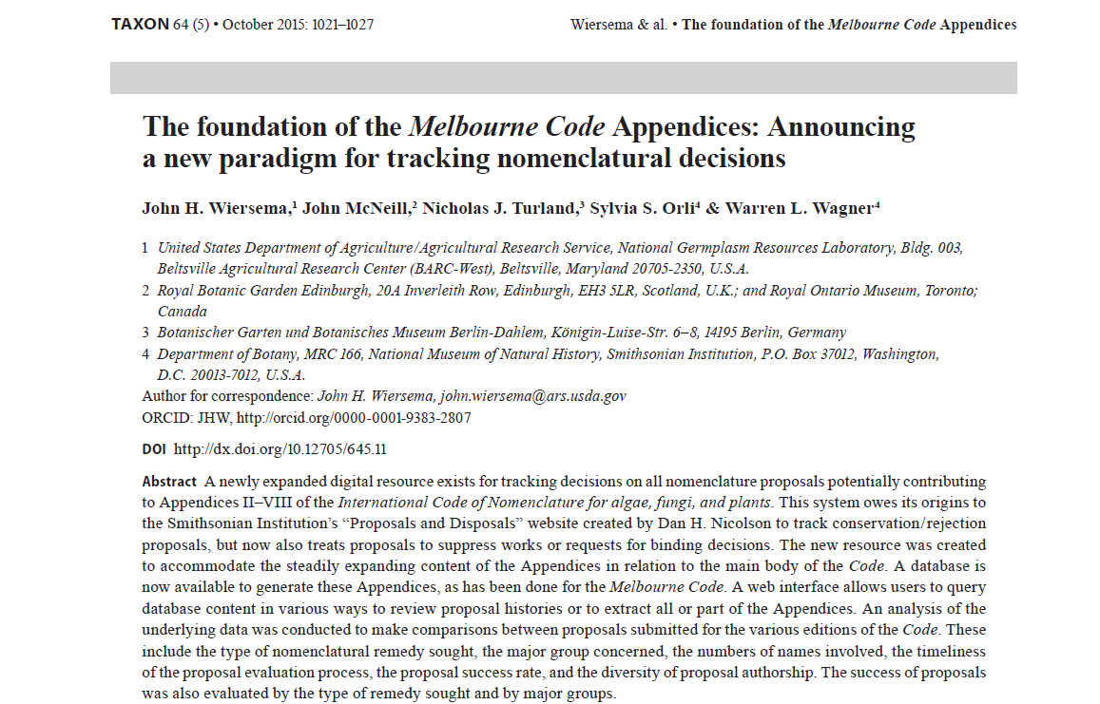

Slide 3
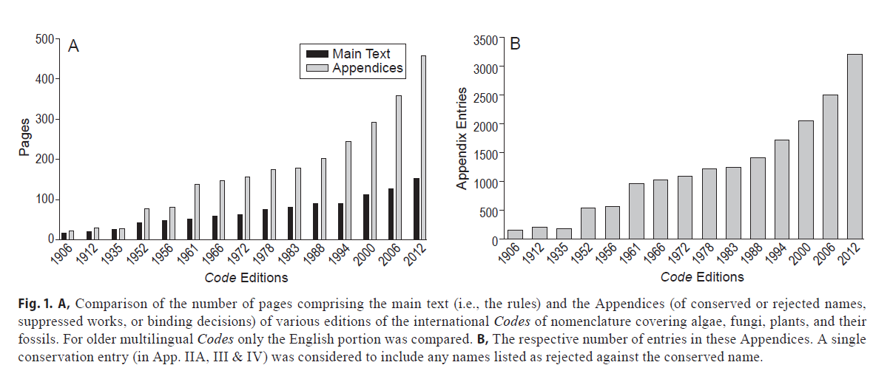
Growth of Code Appendices over time

Slide 4
International Code of Nomenclature for algae, fungi, and plants: Appendices II-VIII
Available online at: http://botany.si.edu/references/codes/props/index.cfm

Slide 5
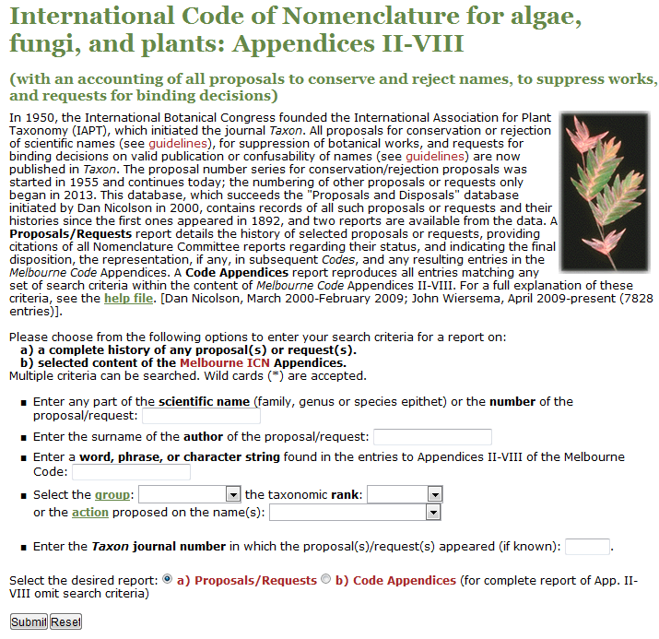

Slide 6
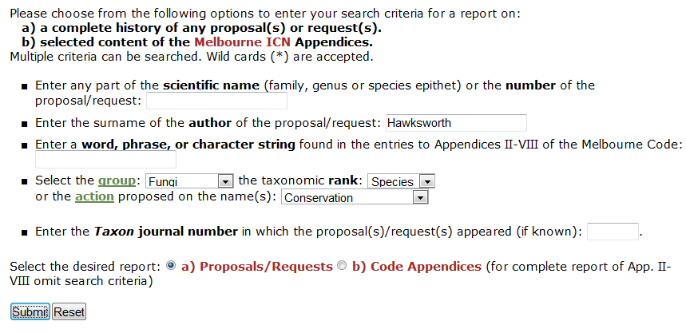

Slide 7
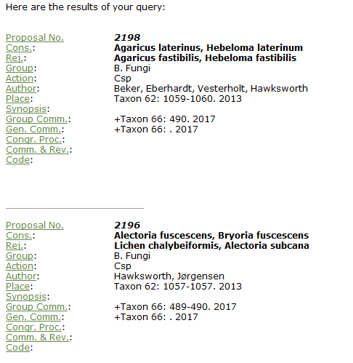

Slide 8
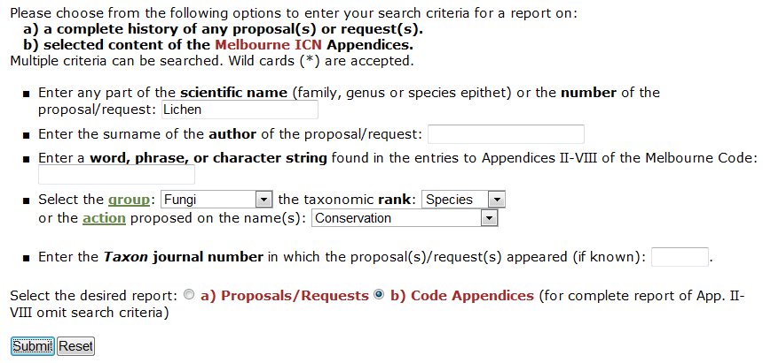

Slide 9
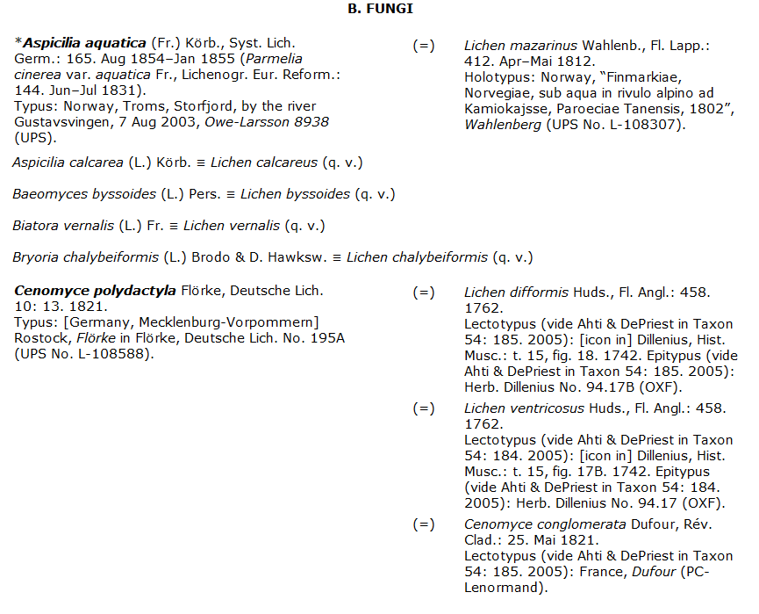

Slide 10
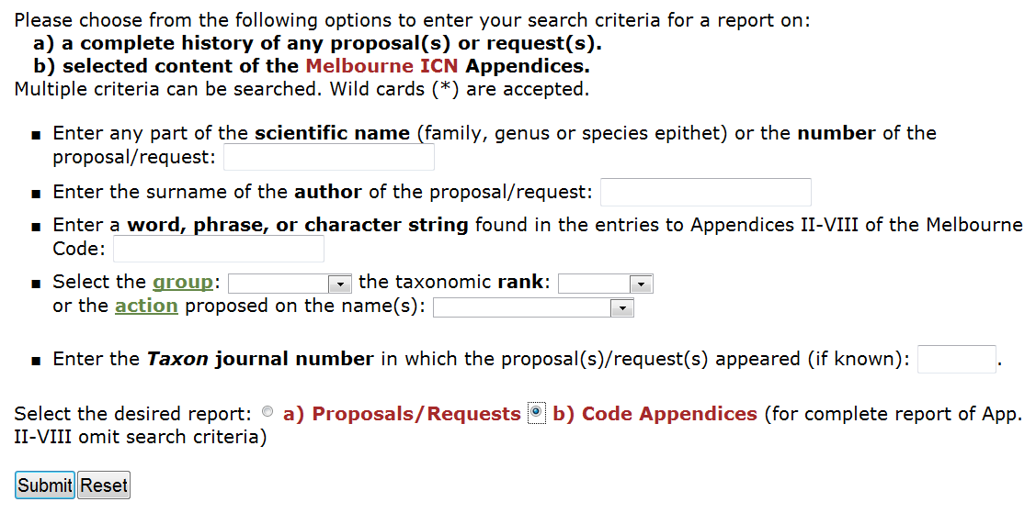
To download full Appendices

Slide 11
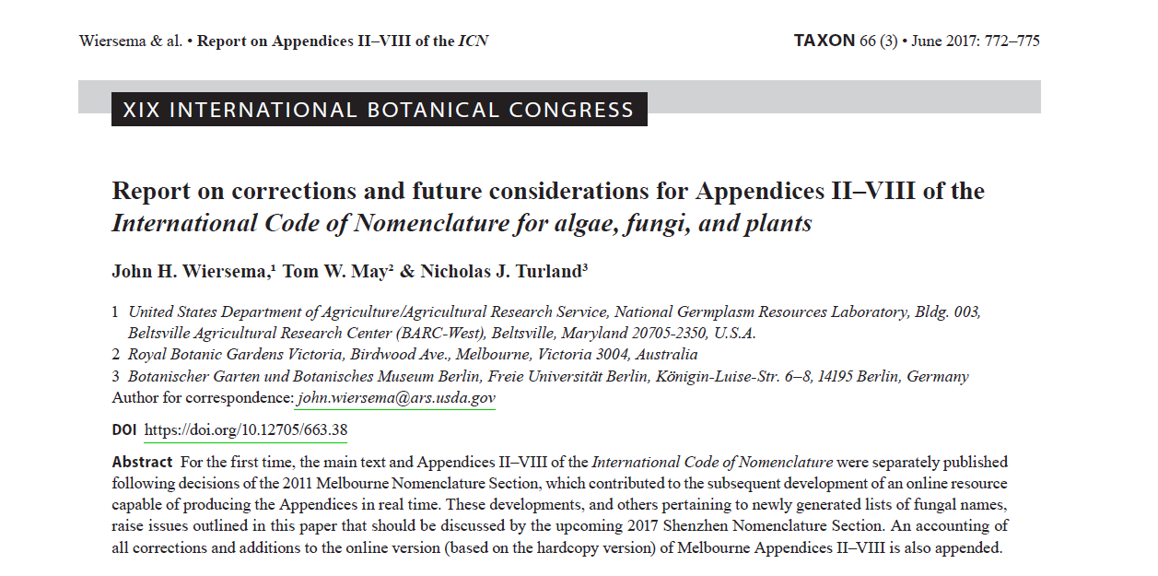

Slide 12
General Questions
Should the Appendices continue to be published as hardcopy as well as in electronic form?
If having both formats is desirable, should the hardcopy be published at the same interval as the main text (every 6 years)?

Slide 13
Online Editing Questions
Should an electronic “snapshot” of each edition of App. II–VIII be archived as a static version (i.e., not to be altered) at some regular interval?
Should a dynamic, corrected version remain available online on demand (i.e., as is currently the situation)?
If yes to the previous two questions, should the dynamic version or the most recent static version be the version that supersedes all others (i.e., considered the “version of record”)?

Slide 14
Lists of Fungal Names
Where to put the 51 names “protected” under Art. 14.13?
How to deal with potential for very large lists under Arts 14.13 and 56.3?
Potential for integration between lists under the Code and nomenclatural indices (e.g. Index Fungorum, Mycobank, and Fungal Names)

